Slide 1
Making a journey
Maths and the environment

Slide 2
How our teaching resources are designed for the classroom

Slide 3
I can assess the implications of making a journey in different ways.

Slide 4
A commute is a regular journey made between a person’s home and their place of work.

Slide 5
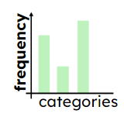
A bar chart (bar graph) is a graph consisting of bars visually representing the frequency of objects or groups.
Speed is the rate at which something is moving. It is measured as the distance travelled per unit of time.

Slide 6

Making a journey
Calculating journey times for different transport
Calculating carbon emissions for journeys
Calculating the cost of a journey

Slide 7
Calculating journey times for different transport
The table shows census data from the Office of National Statistics (ONS) about the distances that people commute in 2021.
distance (d km) | Frequency
d < 2 | 3,057,913
2 ≤ d < 5 | 3,499,333
5 ≤ d < 10 | 3,273,927
10 ≤ d < 20 | 2,924,547
20 ≤ d < 30 | 1,127,371
30 ≤ d < 40 | 470,353
40 ≤ d < 60 | 358,932
60 ≤ d | 382,608
It could be easier to interpret this data if it were represented visually.

Slide 8
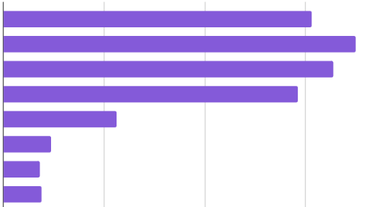
Calculating journey times for different transport
The bar chart shows the same data about the distances that people commute in 2021.
less than 2 km
2 km to less than 5 km
5 km to less than 10 km
10 km to less than 20 km
20 km to less than 30 km
30 km to less than 40 km
40 km to less than 60 km
60 km and over
1
2
3
number of people (millions)

Slide 9
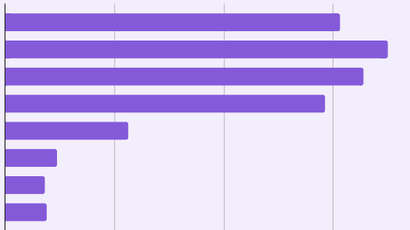
Calculating journey times for different transport
2 km to less than 5 km
Which is the modal group?
less than 2 km
2 km to less than 5 km
5 km to less than 10 km
10 km to less than 20 km
20 km to less than 30 km
30 km to less than 40 km
40 km to less than 60 km
60 km and over
1
2
3
number of people (millions)

Slide 10
Calculating journey times for different transport
Approximately how many people travel between 10 km and 20 km (to 1 significant figure)?
less than 2 km
2 km to less than 5 km
5 km to less than 10 km
10 km to less than 20 km
Approximately 3 million
20 km to less than 30 km
30 km to less than 40 km
40 km to less than 60 km
60 km and over
1
2
3
number of people (millions)

Slide 11
Calculating journey times for different transport
True or false? Over 9 million people travel less than 10 km to work. Justify your answer.
less than 2 km
over 3 million
2 km to less than 5 km
over 3 million
5 km to less than 10 km
over 3 million
10 km to less than 20 km
20 km to less than 30 km
True
Each group under 10 km has a frequency over 3 million.
30 km to less than 40 km
40 km to less than 60 km
60 km and over
1
2
3
number of people (millions)

Slide 12
Calculating journey times for different transport
The table shows average speeds for three methods of transport, when travelling through urban areas.
A person lives 1.5 km from their place of work.
Calculate their expected journey time for each method of transport.
method of transport | average speed (km/h)
walk | 5
cycle | 20
drive | 35
distance
speed =
time

Slide 13
Calculating journey times for different transport
The table shows average speeds for three methods of transport, when travelling through urban areas.
A person lives 1.5 km from their place of work.
Calculate their expected journey time for each method of transport.
method of transport | average speed (km/h)
walk | 5
cycle | 20
drive | 35
distance
time =
speed
walk:
1.5 ÷ 5 = 0.3 hours
0.3 × 60 = 18 minutes

Slide 14
Calculating journey times for different transport
The table shows average speeds for three methods of transport, when travelling through urban areas.
A person lives 1.5 km from their place of work.
Calculate their expected journey time for each method of transport.
method of transport | average speed (km/h)
walk | 5
cycle | 20
drive | 35
distance
time =
speed
cycle:
1.5 ÷ 20 = 0.075 hours
0.075 × 60 = 4.5 minutes

Slide 15
Calculating journey times for different transport
The table shows average speeds for three methods of transport, when travelling through urban areas.
A person lives 1.5 km from their place of work.
Calculate their expected journey time for each method of transport.
method of transport | average speed (km/h)
walk | 5
cycle | 20
drive | 35
distance
time =
speed
drive:
1.5 ÷ 35 = 0.042… hours
0.042… × 60 = 3 minutes (to the nearest min)

Slide 16
Calculating journey times for different transport
A person lives 4 km from their place of work.
How much time could they expect to spend travelling if they cycle to work? Give your answer in hours.
method of transport | average speed (km/h)
walk | 5
cycle | 20
drive | 35
distance
time =
speed
walk:
4 ÷ 20 = 0.2 hours

Slide 17
Calculating journey times for different transport
A person lives 4 km from their place of work.
It takes 0.2 hours to cycle to work. How long is this in minutes?
method of transport | average speed (km/h)
walk | 5
cycle | 20
drive | 35
0.2 × 60 = 12 minutes

Slide 18
Calculating journey times for different transport
A person lives 4 km from their place of work.
How much time could they expect to spend travelling if they drive to work? Give your answer to the nearest minute.
distance
method of transport | average speed (km/h)
walk | 5
cycle | 20
drive | 35
time =
speed
drive:
4 ÷ 35 = 0.1142… hours
0.1142… × 60 = 7 minutes
(to the nearest min)

Slide 19
Calculating journey times for different transport
1) The table shows the distances of three commutes.
Fill in the blanks in the table by calculating the estimated journey times using each method of transport.
method of transport | average speed (km/h) | estimated journey times (to the nearest minute)
 |  | 2 km journey | 8 km journey | 16 km journey
walk | 5
cycle | 20
drive | 35
Which method of transport would you choose to use for each length of journey?

Slide 20
Calculating journey times for different transport
1) The table shows the distances of three commutes.
Fill in the blanks in the table by calculating the estimated journey times using each method of transport.
method of transport | average speed (km/h) | estimated journey times (to the nearest minute)
 |  | 2 km journey | 8 km journey | 16 km journey
walk | 5
cycle | 20
drive | 35
24
96
192
6
24
48
3
14
27

Slide 21


Calculating journey times for different transport
Which method of transport would you choose to use for each length of journey?
Answers may differ depending on personal preferences.
method of transport | average speed (km/h) | estimated journey times (to the nearest minute)
 |  | 2 km journey | 8 km journey | 16 km journey
walk | 5
cycle | 20
drive | 35
192
24
96
48
6
24
27
3
14
I would prefer to always use the fastest mode of transport.
Laura

Slide 22

Calculating journey times for different transport
Which method of transport would you choose to use for each length of journey?
Answers may differ depending on personal preferences.
method of transport | average speed (km/h) | estimated journey times (to the nearest minute)
 |  | 2 km journey | 8 km journey | 16 km journey
walk | 5
cycle | 20
drive | 35
24
96
192
6
24
48
3
14
27
I like walking. But walking for over an hour could be impractical for commuting. So, I would cycle for longer journeys.
Jacob

Slide 23

Calculating journey times for different transport
Which method of transport would you choose to use for each length of journey?
Answers may differ depending on personal preferences.
method of transport | average speed (km/h) | estimated journey times (to the nearest minute)
 |  | 2 km journey | 8 km journey | 16 km journey
walk | 5
cycle | 20
drive | 35
24
96
192
6
24
48
3
14
27
I would like to spend a little bit of time commuting, but not too long. An ideal amount of time for me would be between 15 and 30 minutes.
Aisha

Slide 24
Making a journey
Calculating journey times for different transport
Calculating carbon emissions for journeys
Calculating the cost of a journey

Slide 25
Calculating carbon emissions for journeys
When petrol or diesel vehicles make a journey, they consume fuel.
What factors may affect the amount of fuel that is consumed during a journey?
Examples may include:
length of the journey;
whether driving in a town/city or on a motorway;
size of the vehicle;
size of the engine;
type of fuel.

Slide 26
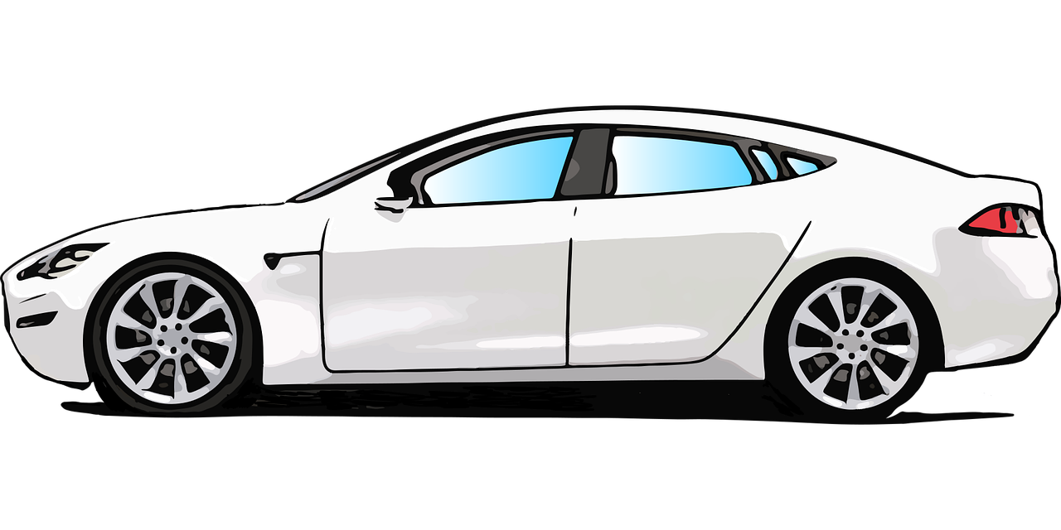
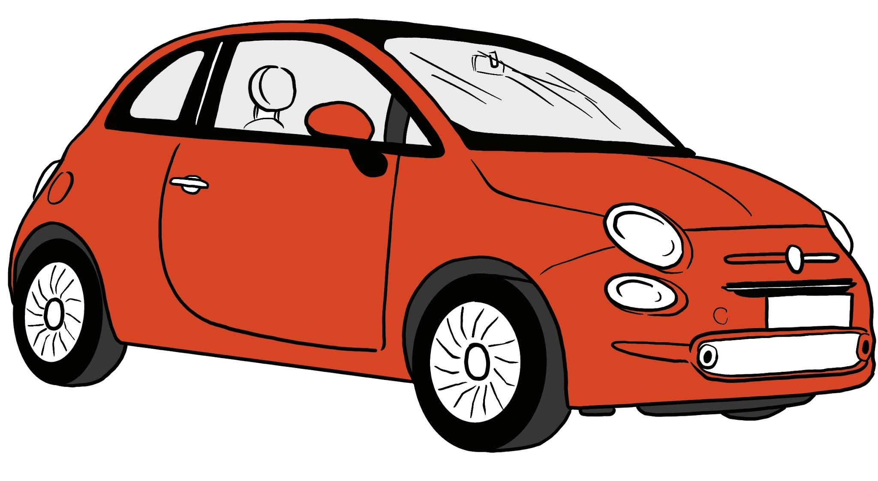
Calculating carbon emissions for journeys
Some vehicles use fuel more efficiently than others.
The fuel efficiency of a vehicle is often expressed in terms of miles per gallon (mpg). This is the average number of miles that the vehicle travels using 1 gallon of fuel. In the UK, a gallon refers to an imperial gallon (rather than a US gallon).
E.g.
A small car may travel 50 mpg on average.
A larger car may travel 35 mpg on average.

Slide 27
Calculating carbon emissions for journeys
The fuel used during a journey produces CO₂ emissions.
We can estimate the amount of CO₂ emissions per mile using the following formula:
CO₂ per gallon of fuel (grams)
emissions per mile (grams) =
fuel efficiency of the vehicle (mpg)

Slide 28
Calculating carbon emissions for journeys
The average CO₂ emissions for a petrol car is 9 kg per gallon.
The average fuel efficiency of a small car is 50 mpg.
How much CO₂ emissions does it produce per mile?
9 kg = 9000 g
CO₂ per gallon of fuel (grams)
emissions per mile (grams) =
fuel efficiency of the vehicle (mpg)
9000
=
50
= 180
The car produces 180 grams of CO₂ emissions per mile.

Slide 29
Calculating carbon emissions for journeys
A person’s car produces 180 grams of CO₂ emissions per mile.
They live 9 miles from their place of work.
How much emissions does the car produce during a journey to work?
× 9
distance (miles) | 1 | 9
C0₂ emissions (grams) | 180
× 180
× 180
1620
× 9
9 × 180 = 1620 grams
Each journey produces 1.62 kg of CO₂ emissions.

Slide 30
Calculating carbon emissions for journeys
A person makes 2 car journeys per day: travelling to work; travelling home from work.
Each journey produces 1.62 kg of CO₂ emissions.
They work 225 days per year.
How much CO₂ emissions does the car produce in a year, travelling to and from work?
1.62 × 2 × 225 = 729 kg
The car produces around 729 kg of CO₂ emissions per year while commuting.

Slide 31
Calculating carbon emissions for journeys
The average CO₂ emissions for a petrol car is 9 kg per gallon.
The average fuel efficiency of a large car is 35 mpg.
How much CO₂ emissions does it produce per mile? Give your answer accurate to 3 significant figures.
CO₂ per gallon of fuel (grams)
emissions per mile (grams) =
fuel efficiency of the vehicle (mpg)
9000 ÷ 35 = 257.142…
The car produces 257 grams of CO₂ emissions per mile.

Slide 32
Calculating carbon emissions for journeys
A person’s car produces 257 grams of CO₂ emissions per mile.
They live 13 miles from their place of work.
How much emissions does the car produce in a single journey to work (one way)? Give your answer in kilograms.
13 × 257 = 3341 grams
Each journey produces 3.341 kg of CO₂ emissions.

Slide 33
Calculating carbon emissions for journeys
A person makes 2 car journeys per day: travelling to work; travelling home from work.
Each journey produces 3.341 kg of CO₂ emissions.
They work 192 days per year.
How much CO₂ emissions does the car produce in a whole year by travelling to and from work?
3.341 × 2 × 192 = 1282.944 kg
The car produces around 1280 kg of CO₂ emissions per year when commuting.

Slide 34
Calculating carbon emissions for journeys
1) The amount of CO₂ emissions per mile can be estimated by using the formula:
CO₂ per gallon of fuel (grams)
emissions per mile (grams) =
fuel efficiency of the vehicle (mpg)
A person lives 6 miles from their place of work and travels by car. The average CO₂ emissions for a petrol car is 9 kg per gallon. On average, their car travels 45 miles per gallon. They work 223 days per year.
Calculate the amount of CO₂ emissions produced per year from commuting by car. Give your answer in kilograms and accurate to 3 significant figures.

Slide 35
Calculating carbon emissions for journeys
2) The amount of CO₂ emissions per mile can be estimated by using the formula:
CO₂ per gallon of fuel (grams)
emissions per mile (grams) =
fuel efficiency of the vehicle (mpg)
40 people live 6 miles from their place of work and travel on the same bus. The average CO₂ emissions for a diesel bus is 10 kg per gallon. On average, the bus travels 8 miles per gallon. They work 223 days per year.
Calculate the amount of CO₂ emissions produced per passenger per year from commuting by bus. Give your answer in kilograms and accurate to 3 significant figures.

Slide 36
Calculating carbon emissions for journeys
1) The amount of CO₂ emissions per mile can be estimated by using the formula:
CO₂ per gallon of fuel (grams)
emissions per mile (grams) =
fuel efficiency of the vehicle (mpg)
A person lives 6 miles from their place of work and travels by car. The average CO₂ emissions for a petrol car is 9 kg per gallon. On average, their car travels 45 miles per gallon. They work 223 days per year.
Calculate the amount of CO₂ emissions produced per year from commuting by car. Give your answer in kilograms and accurate to 3 significant figures.

Slide 37
Calculating carbon emissions for journeys
A person lives 6 miles from their place of work and travels by car. The average CO₂ emissions for a petrol car is 9 kg per gallon. On average, their car travels 45 miles per gallon. They work 223 days per year.
Method 1:
Emissions per mile:
Emissions per journey:
Emissions per day:
Emissions per year:
9000 ÷ 45 = 200 grams of CO₂ per mile
200 × 6 = 1200 grams of CO₂ per journey (1.2 kg)
1.2 × 2 = 2.4 kg of CO₂ per day
2.4 × 223 = 535.2 kg of CO₂ per year
= 535 kg of CO₂ per year (to 3 s.f.)

Slide 38
Calculating carbon emissions for journeys
A person lives 6 miles from their place of work and travels by car. The average CO₂ emissions for a petrol car is 9 kg per gallon. On average, their car travels 45 miles per gallon. They work 223 days per year.
Method 2:
Miles per day:
Miles per year:
Emissions per mile:
Emissions per year:
6 × 2 = 12 miles per day
12 × 223 = 2676 miles per year
9000 ÷ 45 = 200 grams of CO₂ per mile
2676 × 200 = 535 200 grams of CO₂ per year
= 535 kg of CO₂ per year (to 3 s.f.)

Slide 39
Calculating carbon emissions for journeys
2) The amount of CO₂ emissions per mile can be estimated by using the formula:
CO₂ per gallon of fuel (grams)
emissions per mile (grams) =
fuel efficiency of the vehicle (mpg)
40 people live 6 miles from their place of work and travel on the same bus. The average CO₂ emissions for a diesel bus is 10 kg per gallon. On average, the bus travels 8 miles per gallon. They work 223 days per year.
Calculate the amount of CO₂ emissions produced per passenger per year from commuting by bus. Give your answer in kilograms and accurate to 3 significant figures.

Slide 40
Calculating carbon emissions for journeys
40 people live 6 miles from their place of work and travel on the same bus. The average CO₂ emissions for a diesel bus is 10 kg per gallon. On average, the bus travels 8 miles per gallon. They work 223 days per year.
Emissions per mile:
Emissions per journey:
Emissions per day:
Emissions per year:
Annual emissions per person:
10 000 ÷ 8 = 1250 grams of CO₂ per mile (1.25 kg)
1.25 × 6 = 7.5 kg of CO₂ per journey
7.5 × 2 = 15 kg of CO₂ per day
15 × 223 = 3345 kg of CO₂ per year
3345 ÷ 40 = 83.6 kg of CO₂ per person (to 3 s.f.)
Alternative methods may be also used to derive the same answer.

Slide 41
Making a journey
Calculating journey times for different transport
Calculating carbon emissions for journeys
Calculating the cost of a journey

Slide 42
Calculating the cost of a journey
The fuel economy of a vehicle is often expressed in terms of miles per gallon (mpg). This is the average number of miles that the vehicle can travel using 1 gallon of fuel.
In the UK, petrol and diesel is sold in litres.
We can use the fact that 1 gallon is approximately 4.546 litres to convert between units.
1 gallon ≈ 4.546 litres
× 4.546
gallons litres
÷ 4.546
gallons litres

Slide 43
Calculating the cost of a journey
A person drives 9 miles to work. The average fuel efficiency of their car is 50 mpg. Petrol costs 142.9 p per litre. 1 gallon ≈ 4.546 litres.
What is the cost of the petrol for journey?
Plan:
1. Calculate the amount of petrol used in gallons.
2. Convert the amount of petrol into litres.
3. Calculate the cost of the petrol.

Slide 44
Calculating the cost of a journey
A person drives 9 miles to work. The average fuel efficiency of their car is 50 mpg. Petrol costs 142.9 p per litre. 1 gallon ≈ 4.546 litres.
What is the cost of the petrol for journey?
1. Calculate the amount of petrol used in gallons.
miles | 50 | 9
gallons | 1
÷ 50
÷ 50
0.18
Each journey uses 0.18 gallons of petrol.

Slide 45
Calculating the cost of a journey
A person drives 9 miles to work. The average fuel efficiency of their car is 50 mpg. Petrol costs 142.9 p per litre. 1 gallon ≈ 4.546 litres.
What is the cost of the petrol for journey?
2. Convert the amount of petrol into litres.
Each journey uses 0.18 gallons of petrol.
0.18 × 4.546 = 0.81828
Each journey uses 0.81828 L of petrol.

Slide 46
Calculating the cost of a journey
A person drives 9 miles to work. The average fuel efficiency of their car is 50 mpg. Petrol costs 142.9 p per litre. 1 gallon ≈ 4.546 litres.
What is the cost of the petrol for journey?
3. Calculate the cost of the petrol.
Each journey uses 0.81828 L of petrol.
0.81828 × 142.9 = 116.932212 p
The cost of petrol for each journey approximately £1.17

Slide 47
Calculating the cost of a journey
A person’s car journey to work costs £1.17 in terms of petrol.
They make the journey twice a day for 225 days a year.
What is the annual cost of petrol for commuting to work?
1.17 × 2 × 225 = 526.5
Commuting by car costs approximately £526.50 per year for petrol.

Slide 48
Calculating the cost of a journey
A person spends £526.50 per year on petrol to commute to work.
They also pay £80 per month for car insurance.
The annual cost of maintenance for the car is £650.
Assume that they only own their car so that they can drive to work. How much do they spend in total on their car each year?
526.5 + 12 × 80 + 650 = 2136.5
The person spends approximately £2136.50 on their car per year to commute to work.

Slide 49

Calculating the cost of a journey
A person drives 12 miles to work. They travel to and from work on 225 days of the year. The average fuel efficiency of their car is 40 mpg. Petrol costs 138.9 p per litre. 1 gallon ≈ 4.546 litres.
Match each calculation with what it represents in context.
1 ÷ 40 = 0.025
cost per journey (£)
a
0.025 × 12 = 0.3
b
cost per year (£)
0.3 × 4.546 = 1.3638
c
gallons of petrol consumed per journey
1.3638 × 1.389 = 1.894…
d
gallons of petrol consumed per mile
1.894… × 2 × 225 = £852.44
e
litres of petrol consumed per journey

Slide 50
Calculating the cost of a journey
A person drives 12 miles to work. They travel to and from work on 225 days of the year. The average fuel efficiency of their car is 40 mpg. Petrol costs 138.9 p per litre. 1 gallon ≈ 4.546 litres.
Match each calculation with what it represents in context.
12 × 2 × 225 = 5400
a
annual cost of petrol (in pence)
1 ÷ 40 = 0.025
b
gallons of petrol consumed per mile
0.025 × 5400 = 135
c
gallons of petrol consumed per year
135 × 4.546 = 613.71
d
litres of petrol consumed per year
613.71 × 138.9 = 85 244.319
e
miles travelled per year

Slide 51
Calculating the cost of a journey
1) A person lives 6 miles from their place of work and travels by car 225 days per year. On average, their car travels 45 miles per gallon. At their nearest petrol station, petrol is sold for 148.9 p per litre. 1 gallon ≈ 4.546 litres.
a) How much do they spend on petrol per year for commuting by car?
b) Their car insurance costs £65 per month. Their annual maintenance costs sum to £820. Assume that they only use the car for commuting. How much do they spend in total on their car each year?
c) They are considering selling their car and commuting by bus. A weekly bus pass in their town costs £22 per week. Assume that they would buy a weekly bus pass every week of the year. Would commuting by bus cost more or less money per year? Justify you answer.

Slide 52
Calculating the cost of a journey
1) A person lives 6 miles from their place of work and travels by car 225 days per year. On average, their car travels 45 miles per gallon. At their nearest petrol station, petrol is sold for 148.9 p per litre. 1 gallon ≈ 4.546 litres.
a) How much do they spend on petrol per year for commuting by car?
Example solution strategy:
Miles per year:
Gallons per mile:
Gallons per year:
Litres per year:
Cost per year:
6 × 2 × 225 = 2700 miles per year
.
1 ÷ 45 = 0.02 gallons per mile
.
0.02 × 2700 = 60 gallons per year
60 × 4.546 = 272.76 litres per year
272.76 × 1.489 = £406.14 per year

Slide 53
Calculating the cost of a journey
a) How much do they spend on petrol per year for commuting by car? £406.14
b) Their car insurance costs £65 per month. Their annual maintenance costs sum to £820. Assume that they only use the car for commuting. How much do they spend in total on their car each year?
406.14 + 12 × 65 + 820 = £2006.14
c) They are considering selling their car and commuting by bus. A weekly bus pass in their town costs £22 per week. Assume that they would buy a weekly bus pass every week of the year. Would commuting by bus cost more or less money per year? Justify you answer.
Annual cost of buying weekly bus passes: 22 × 52 = £1144
It would cost less per year.

Slide 54
Making a journey
There may be many options for how to travel to a place.
Various factors affect which mode of transport is preferable. Examples include time, cost and environmental impact.
Calculations can be used to make comparisons between different methods of transport to support decision making.
Making the same journey multiple times means the impact of that journey is multiplied.

Slide 55

© Oak National Academy 2024.
Produced in partnership with Mathematics in Education and Industry.
Licensed on the Open Government Licence v3.0, except where otherwise stated. See Oak terms and conditions.

